Slide 1
Chapter 3 Objectives
The CCNA Topics Covered in this chapter include:
  How Ping works
  How traceroute works
  ARP
  RARP
  DHCP
  DNS

Slide 2



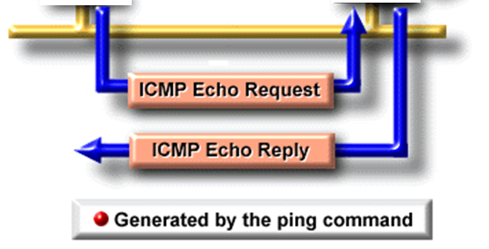
ICMP – Internet Control Message Protocol
10.20.30.4
10.20.30.3

Slide 3
Ping
Uses ICMP message within an IP Packet, Protocol field = 1
Format
ping <ip address> (or ping <cr> for extended ping)
ping 10.20.30.3
Echo Request
The sender of the ping, transmits an ICMP message, “Echo Request”
Echo Reply
The IP address (destination) of the ping, receives the ICMP message, “Echo Request”
The ip address (destination) of the ping, returns the ICMP message, “Echo Reply”
If datagrams cannot always be forwarded to their destinations, ICMP delivers back to the sender a destination unreachable message indicating to the sender that the datagram could not be properly forwarded.

Slide 4
C:\>ping google.com
Pinging google.com [209.85.231.104] with 32 bytes of data:
Reply from 209.85.231.104: bytes=32 time=40ms TTL=55
Reply from 209.85.231.104: bytes=32 time=40ms TTL=55
Reply from 209.85.231.104: bytes=32 time=39ms TTL=55
Reply from 209.85.231.104: bytes=32 time=39ms TTL=55
Ping statistics for 209.85.231.104:
Packets: Sent = 4, Received = 4, Lost = 0 (0% loss),
Approximate round trip times in milli-seconds:
Minimum = 39ms, Maximum = 40ms, Average = 39ms
C:\>

Slide 5
Traceroute
Time to Live (TTL) is an eight-bit field in IP header that will be set with a certain number when the packet is first generated. As the packet is passed from router to router, each router will decrement this number. If the number reaches zero, the packet will be discarded and an error message will be sent to the source. This process prevents "lost" packets from wandering endlessly through a network.
Traceroute
Trace (Cisco = traceroute) is used to show the path the packet take to the destination

Slide 6
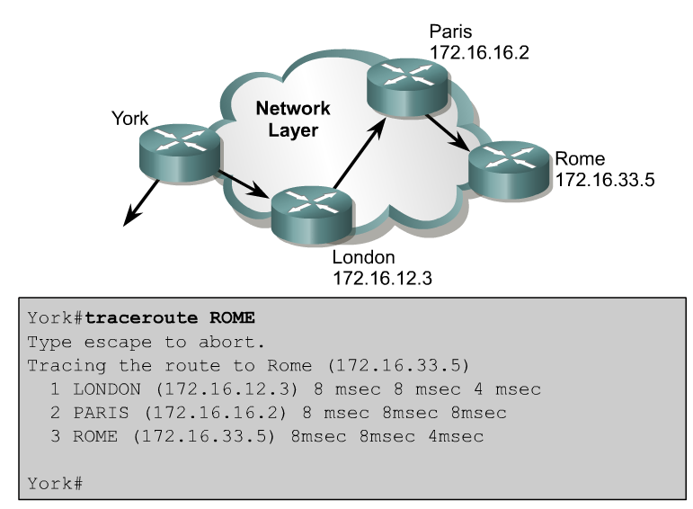
Alternative connectivity tests
The traceroute command is the ideal tool for finding where data is being sent in a network.
If one of these routers is unreachable, three asterisks (*) will be returned instead of the name of the router.
The traceroute command will continue attempting to reach the next step until the Ctrl-Shift-6 escape sequence is used.

Slide 7
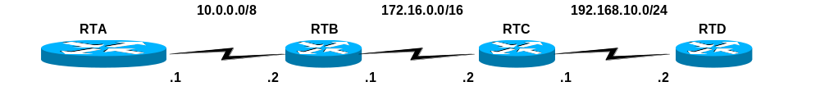
RTA# traceroute ip address
RTA# traceroute 192.168.10.2

Slide 8
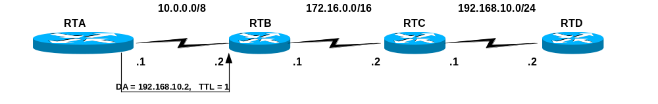
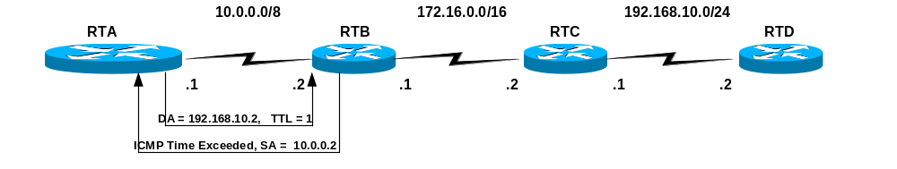
How it works - Fooling the routers & host!
Traceroute uses ping (echo requests)
Traceroute sets the TTL (Time To Live) field in the IP Header, initially to “1”
RTB - TTL:
When a router receives an IP Packet, it decrements the TTL by 1.
If the TTL is 0, it will not forward the IP Packet, and send back to the source an ICMP “time exceeded” message.

Slide 9
RTB
After the traceroute is received by the first router, it decrements the TTL by 1 to 0.
Noticing the TTL is 0, it sends back a ICMP Time Exceeded message back to the source, using its IP address for the source IP address.
Router B’s IP header includes its own IP address (source IP) and the sending host’s IP address (dest. IP).
RTA, Sending Host
The traceroute program of the sending host (RTA) will use the source IP address of this ICMP Time Exceeded packet to display at the first hop.
RTA# traceroute 192.168.10.2
Type escape sequence to abort.
Tracing the route to 192.168.10.2
1 10.0.0.2 4 msec 4 msec 4 msec

Slide 10
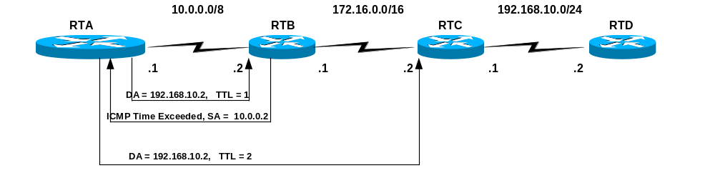
RTA
The traceroute program increments the TTL by 1 (now 2 ) and resends the ICMP Echo Request packet.

Slide 11
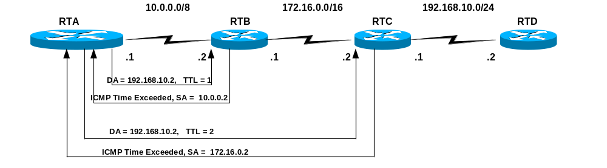
RTB
This time RTB decrements the TTL by 1 and it is NOT 0. (It is 1.)
So it looks up the destination ip address in its routing table and forwards it on to the next router.
RTC
RTC however decrements the TTL by 1 and it is 0.
RTC notices the TTL is 0 and sends back the ICMP Time Exceeded message back to the source.
RTC’s IP header includes its own IP address (source IP) and the sending host’s IP address (destination IP address of RTA).
The sending host, RTA, will use the source IP address of this ICMP Time Exceeded message to display at the second hop.

Slide 12
The sending host, RTA:
The traceroute program uses this information (Source IP Address) and displays the second hop.
RTA# traceroute 192.168.10.2
Type escape sequence to abort.
Tracing the route to 192.168.10.2
1 10.0.0.2 4 msec 4 msec 4 msec
2 172.16.0.2 20 msec 16 msec 16 msec

Slide 13
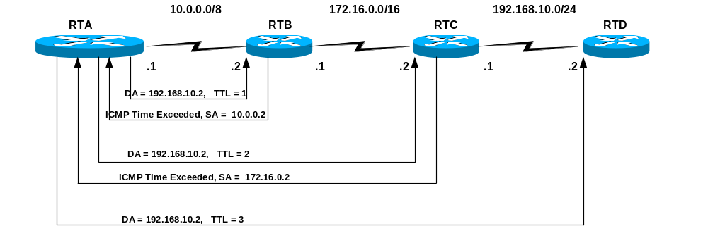
The sending host, RTA:
The traceroute program increments the TTL by 1 (now 3 ) and resends the Packet.
RTB
This time RTB decrements the TTL by 1 and it is NOT 0. (It is 2.)
So it looks up the destination ip address in its routing table and forwards it on to the next router.
RTC
This time RTC decrements the TTL by 1 and it is NOT 0. (It is 1.)
So it looks up the destination ip address in its routing table and forwards it on to the next router.
RTD
RTD however decrements the TTL by 1 and it is 0.
However, RTD notices that the Destination IP Address of 192.168.0.2 is it’s own interface.
Since it does not need to forward the packet, the TTL of 0 has no affect.

Slide 14
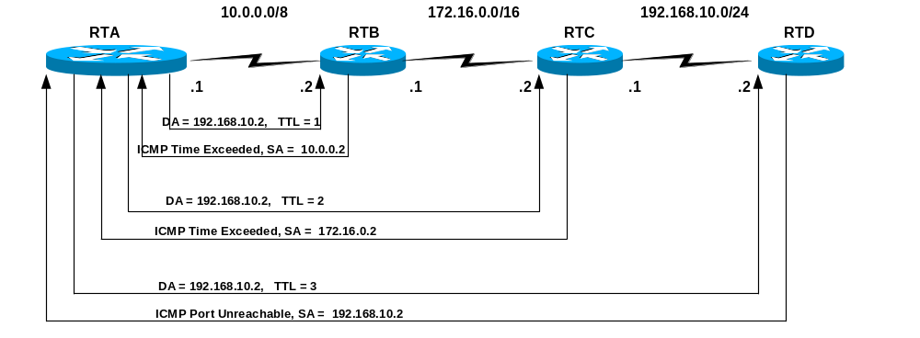
Sending host, RTA
RTA receives the ICMP Port Unreachable message.
The traceroute program uses this information (Source IP Address) and displays the third hop.
The traceroute program also recognizes this Port Unreachable message as meaning this is the destination it was tracing.

Slide 15
Sending host, RTA
RTA, the sending host, now displays the third hop.
Getting the ICMP Port Unreachable message, it knows this is the final hop and does not send any more traces (echo requests).
RTA# traceroute 192.168.10.2
Type escape sequence to abort.
Tracing the route to 192.168.10.2
1 10.0.0.2 4 msec 4 msec 4 msec
2 172.16.0.2 20 msec 16 msec 16 msec
3 192.168.10.2 16 msec 16 msec 16 msec

Slide 16
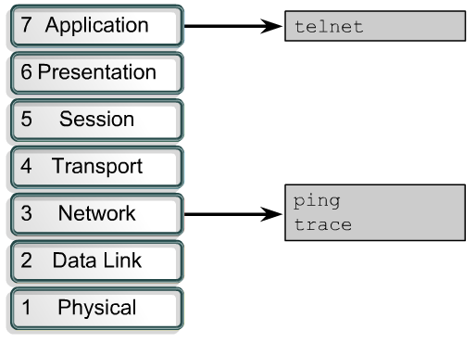
Troubleshooting IP addressing issues
ping uses the ICMP protocol to verify the hardware connection and the IP address of the network layer. This is a basic testing mechanism.
telnet verifies the application layer software between source and destination. This is the most complete test mechanism available.
traceroute allows the location of failures in the path from the source to the destination. Trace uses Time to Live values to generate messages from each router along the path.

Slide 17
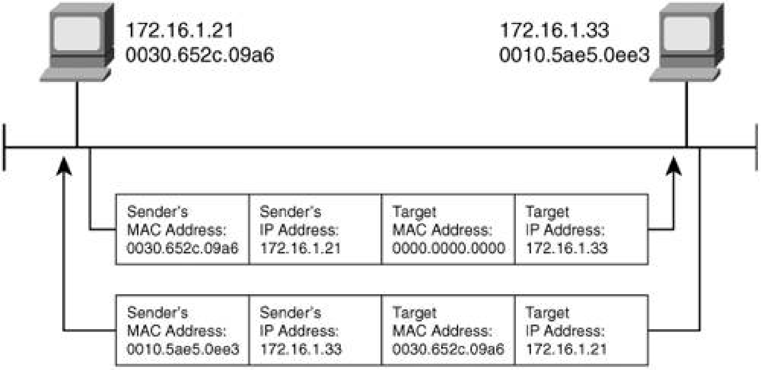
ARP – Address Resolution Protocol
ARP resolves IP addresses to Ethernet (MAC) addresses.
Arp Request
Arp Reply

Slide 18
An analyzer capture of the ARP Request
Ethernet II, Src: 00:30:65:2c:09:a6, Dst: ff:ff:ff:ff:ff:ff
Destination: ff:ff:ff:ff:ff:ff (Broadcast)
Source: 00:30:65:2c:09:a6 (AcroCom_2c:09:a6)
Type: ARP (0x0806)
Address Resolution Protocol (request)
Hardware type: Ethernet (0x0001)
Protocol type: IP (0x0800)
Hardware size: 6
Protocol size: 4
Opcode: request (0x0001)
Sender MAC address: 00:30:65:2c:09:a6 (AcroCom_2c:09:a6)
Sender IP address: 172.16.1.21 (172.16.1.21)
Target MAC address: 00:00:00:00:00:00 (00:00:00_00:00:00)
Target IP address: 172.16.1.33 (172.16.1.33)

Slide 19
Arp Cache
C:\>arp -a
Interface: 192.128.5.2 --- 0x3
Internet Address Physical Address Type
192.128.5.1 00-08-5c-8e-4f-a2 dynamic
Interface: 10.209.240.95 --- 0x10005
Internet Address Physical Address Type
10.209.194.16 00-ff-5b-fa-3e-8a dynamic
10.209.194.27 00-ff-5b-fa-3e-8a dynamic
10.209.194.50 00-ff-5b-fa-3e-8a dynamic
61.246.63.72 00-ff-5b-fa-3e-8a dynamic
61.246.63.80 00-ff-5b-fa-3e-8a dynamic
63.150.131.164 00-ff-5b-fa-3e-8a dynamic
63.150.131.179 00-ff-5b-fa-3e-8a dynamic
66.129.252.125 00-ff-5b-fa-3e-8a dynamic

Slide 20

Reverse ARP (RARP)
I heard that broadcast. Your IP address is 172.16.3.25.
What is my IP address?
Ethernet: 0800.0020.1111 IP = ???
Ethernet: 0800.0020.1111
IP: 172.16.3.25

Slide 21
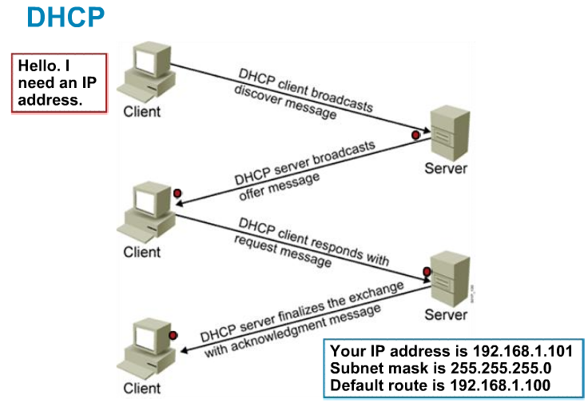
Dynamic Host Configuration Protocol
Dynamic Host Configuration Protocol (DHCP) is used to provide IP information to hosts on your network. DHCP can provide a lot of information, but the most common is IP address, subnet mask, default gateway, and DNS information.

Slide 22

Domain Name Server ( DNS )
C:\>ipconfig /all

